Slide 1
OCR-Based Autograder for Handwritten Content
Nina Nguyen

Slide 2
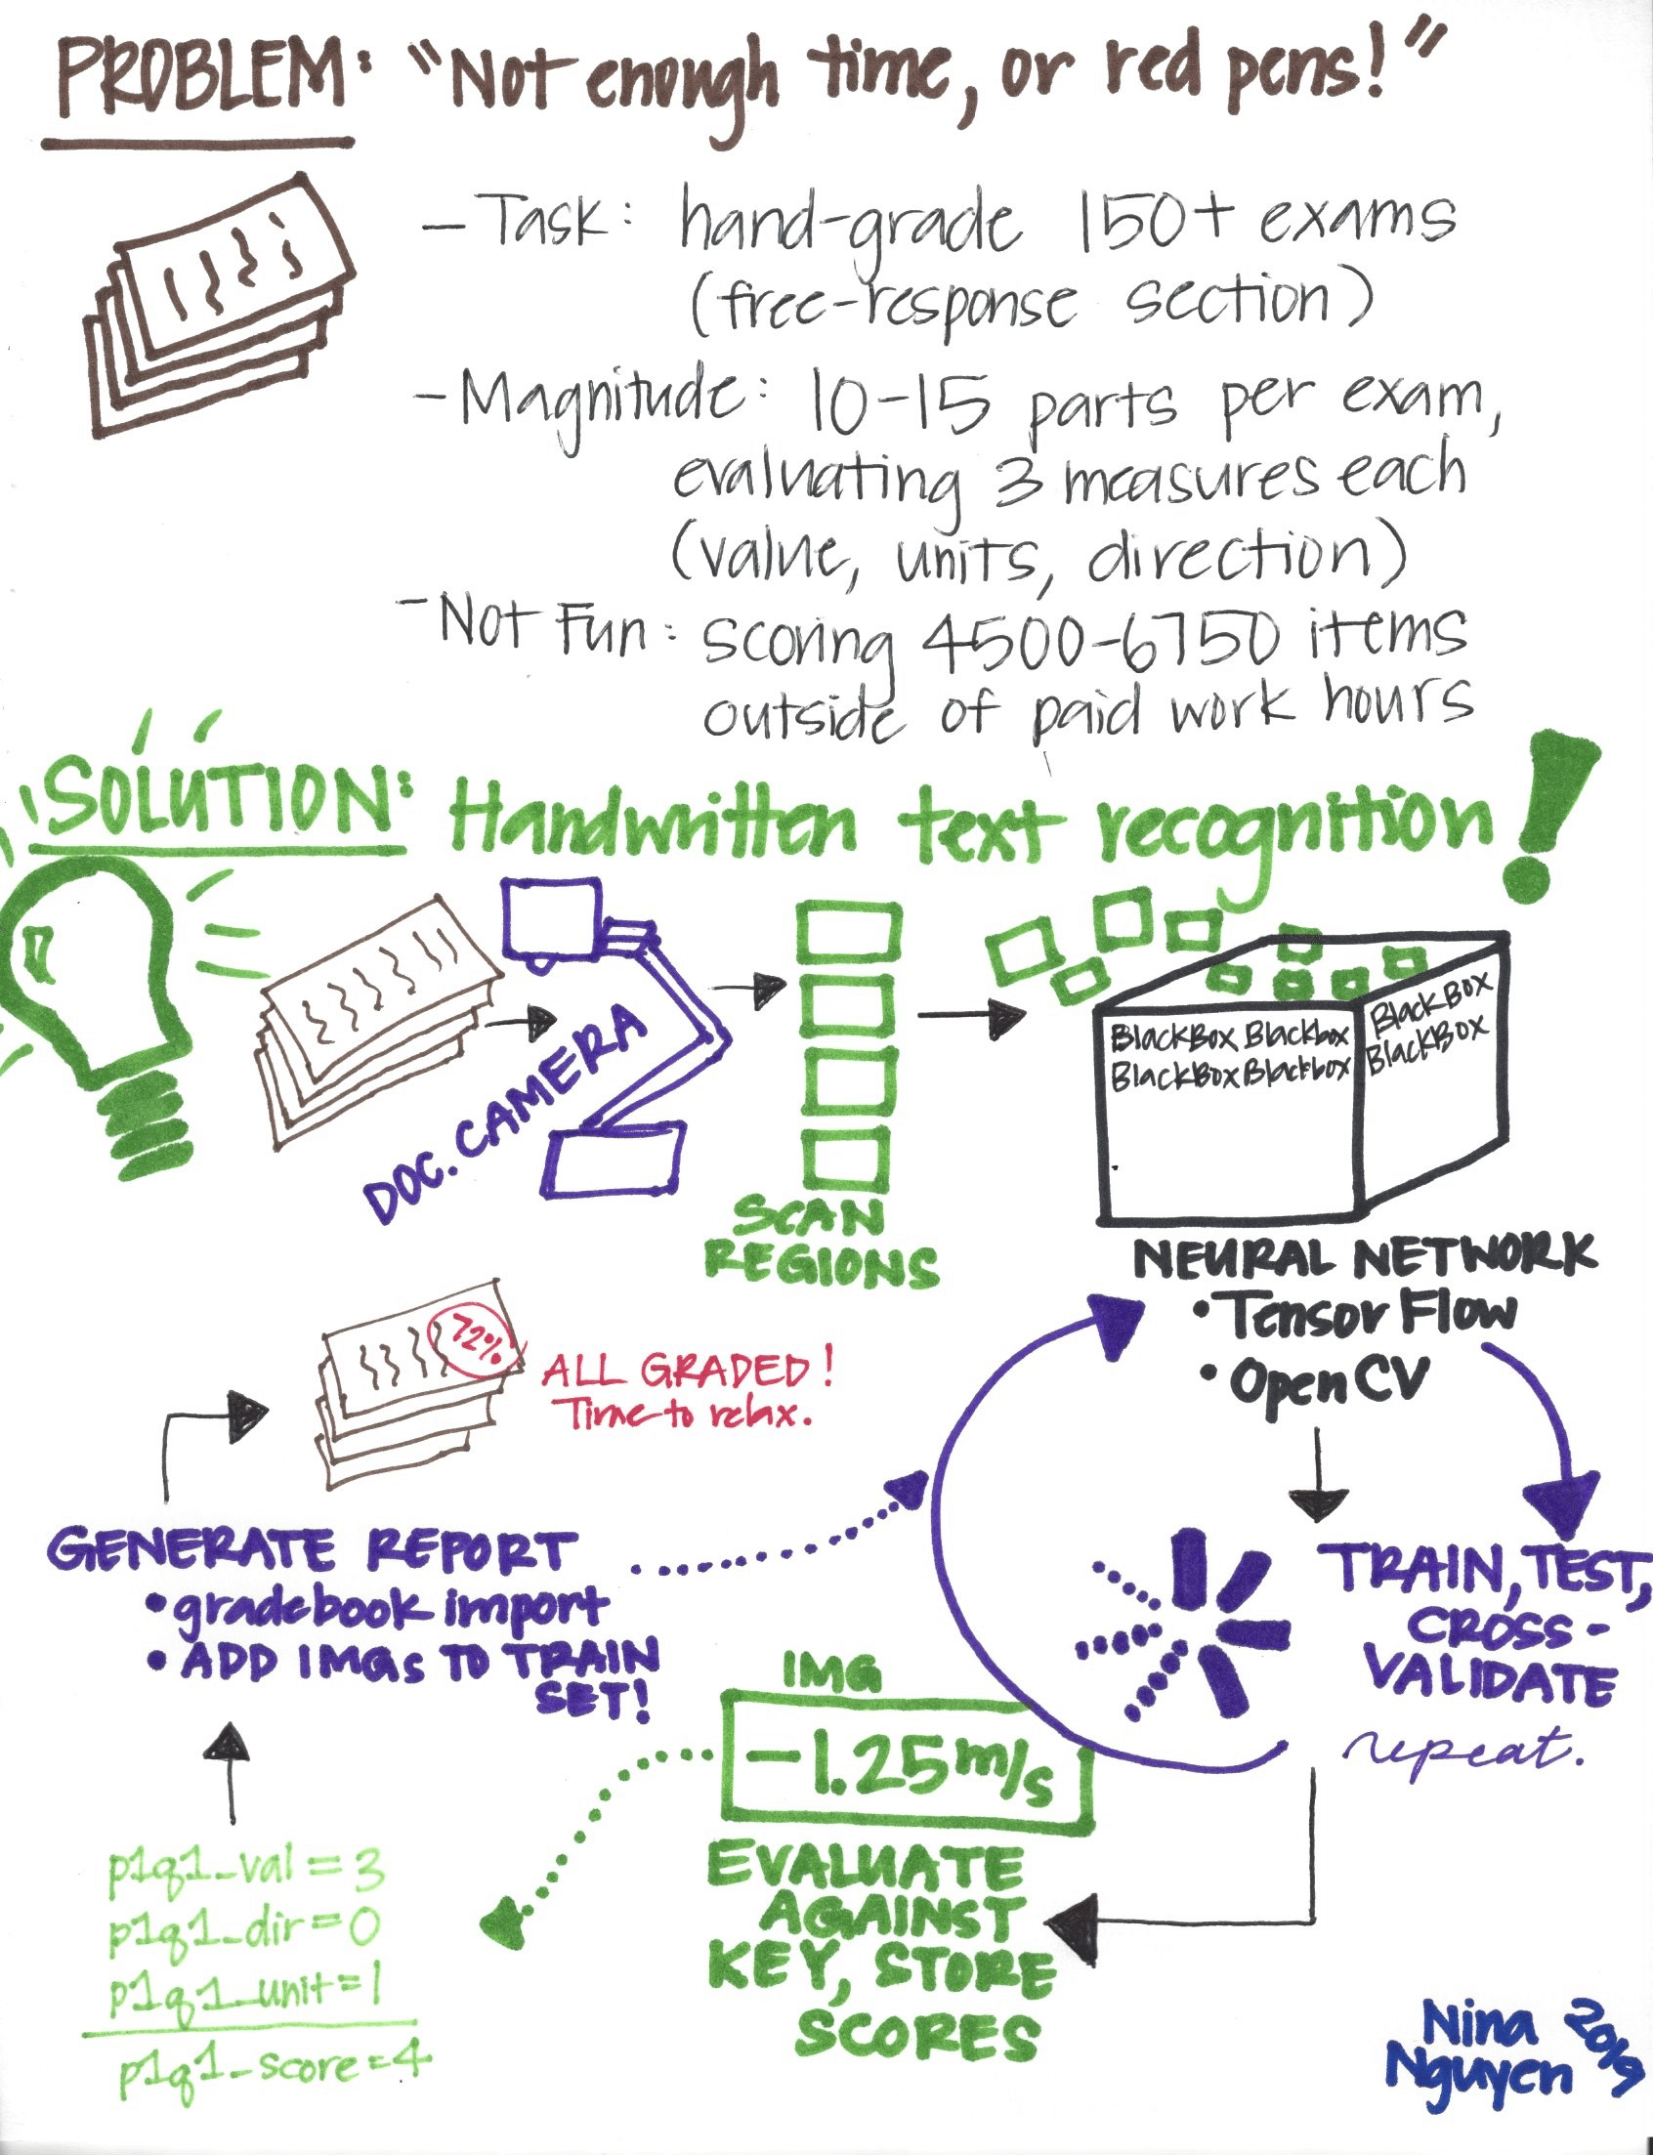
The Problem
Hand grading free-response questions for physics and math is a pain.
It is a monotonous process that can be automated due to limited characters and symbols, unlike English/history.
In other words: “Why do I even need you here? I can just write a bot.”
Why should a human do this when a computer can?

Slide 3

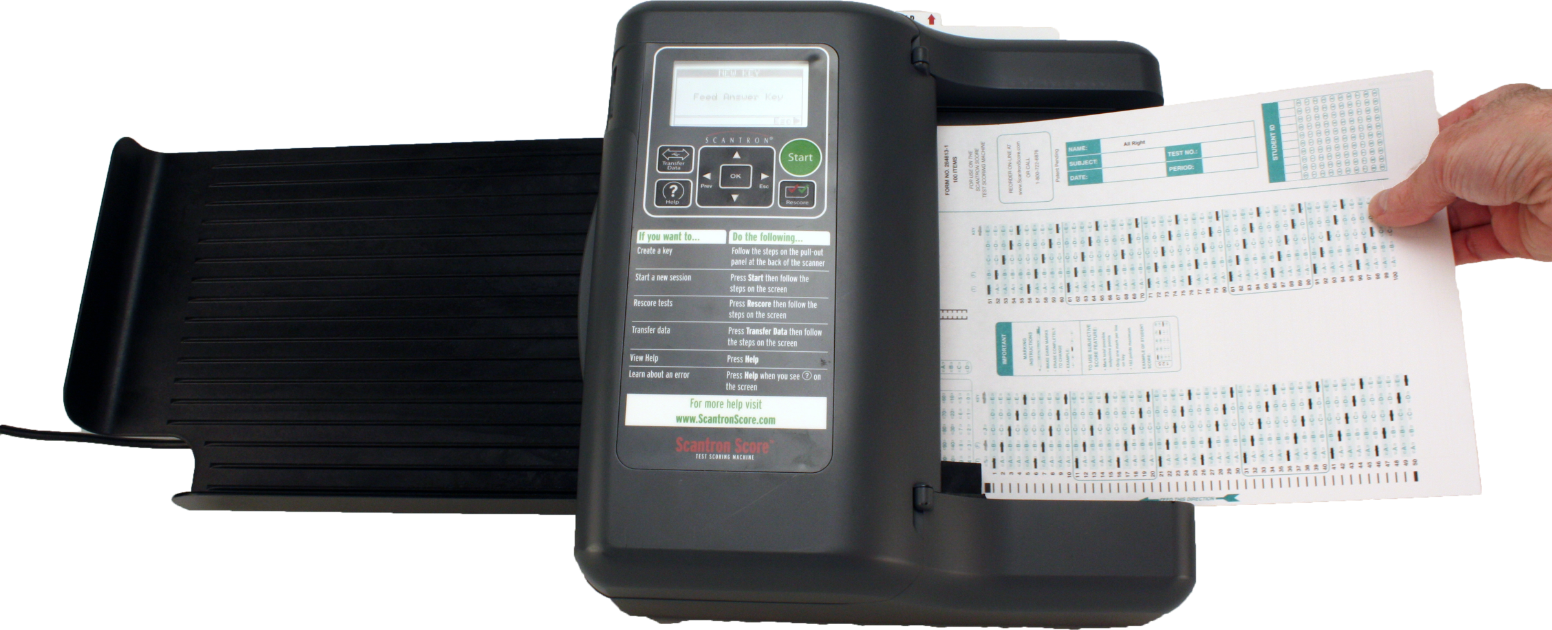
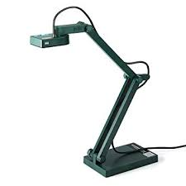
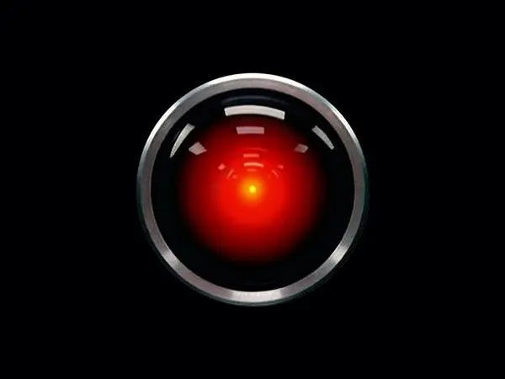


Inspiration
Illuminate has rendered ScanTron obsolete with OCR grading.
Key Features:
Test-specific forms
Automatic gradebook entry
Doc cam or webcam

Slide 4
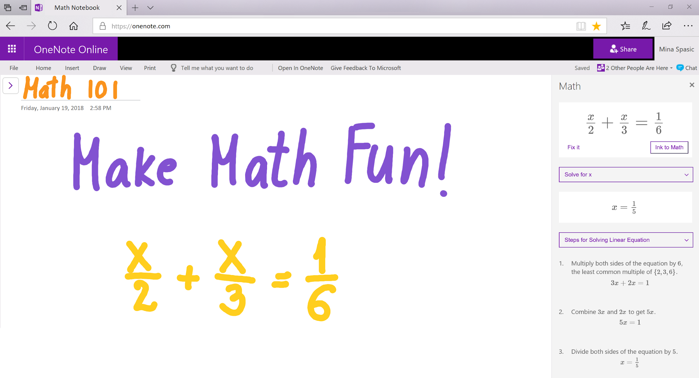


Ink-spiration
Penstroke recognition by Microsoft

Slide 5
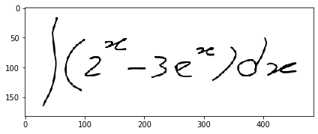
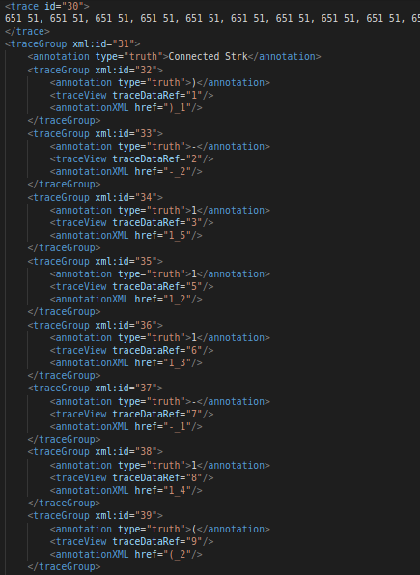
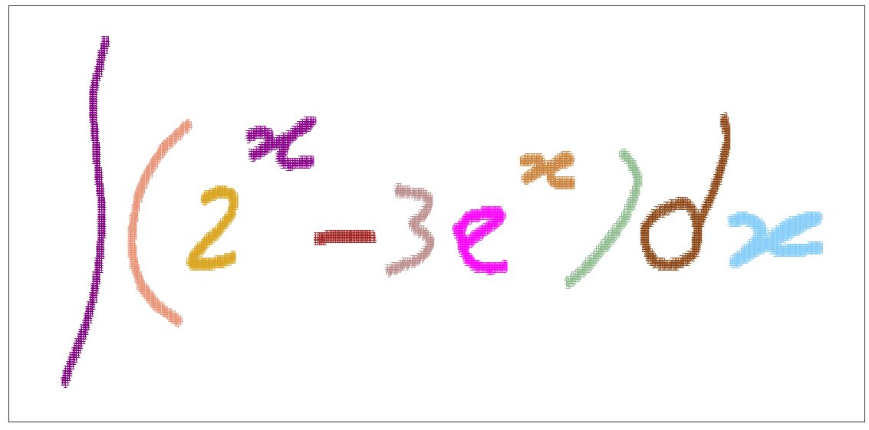
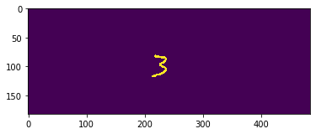
General Process
Raw Image
Segmentation
Object isolation/processing
0) Convert InkML to .png
InkML is a XML data type for digital ink data obtained from an electronic pen or stylus.

Slide 6
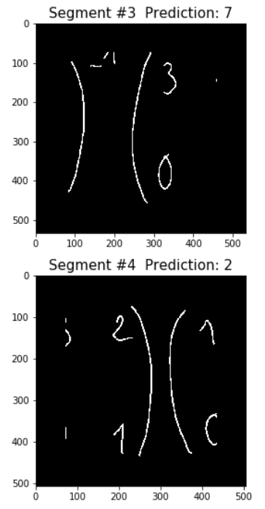
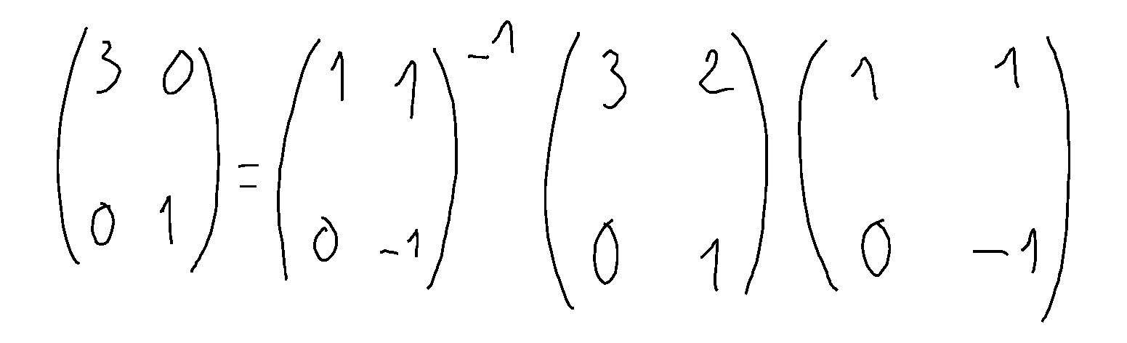
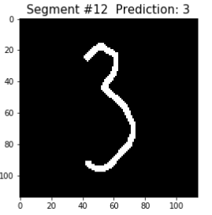
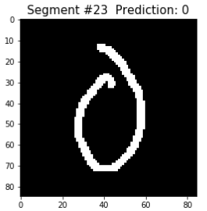
Segmentation Challenges
…...But wait, there’s more!
How many segments do you see?
As expected, we get:
and so on...

Slide 7
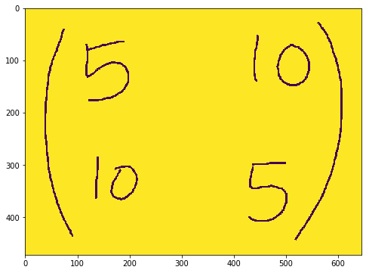
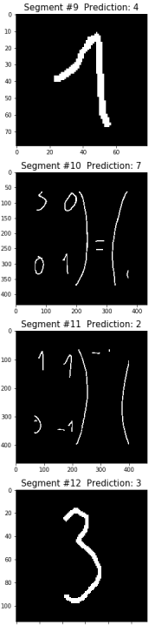
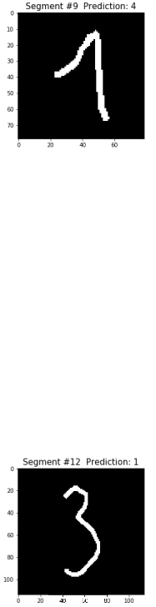
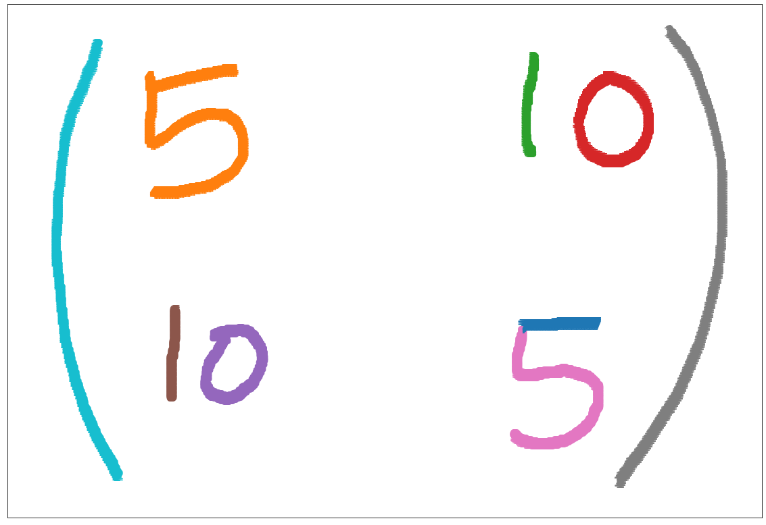
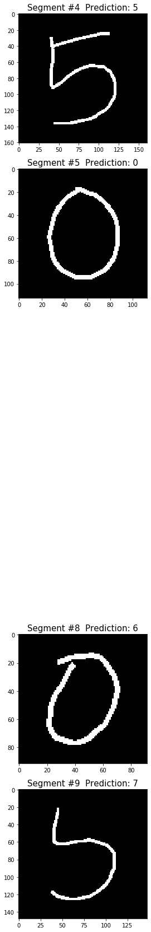
Segmentation Challenges
Write code to ignore such segments before isolation.
...which helps most things,
but can cause other issues.

Slide 8
Simplify the Problem at Hand: Generate Test Images

Slide 9
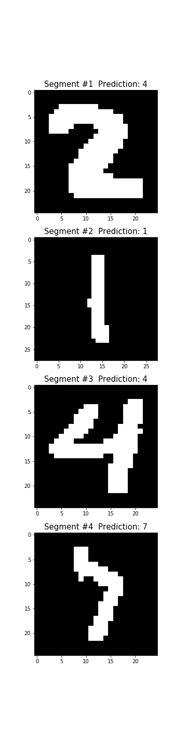
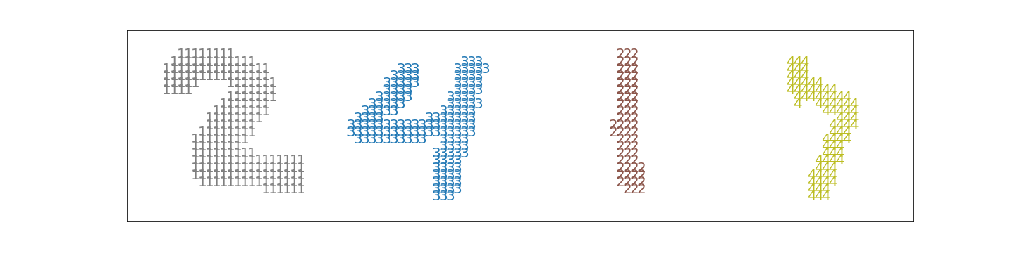
Process
Raw Image Creation
Segmentation
The Fun Part
Isolate objects
Make square (non-trivial task)
Resize to 28x28
Make individual predictions

Slide 10
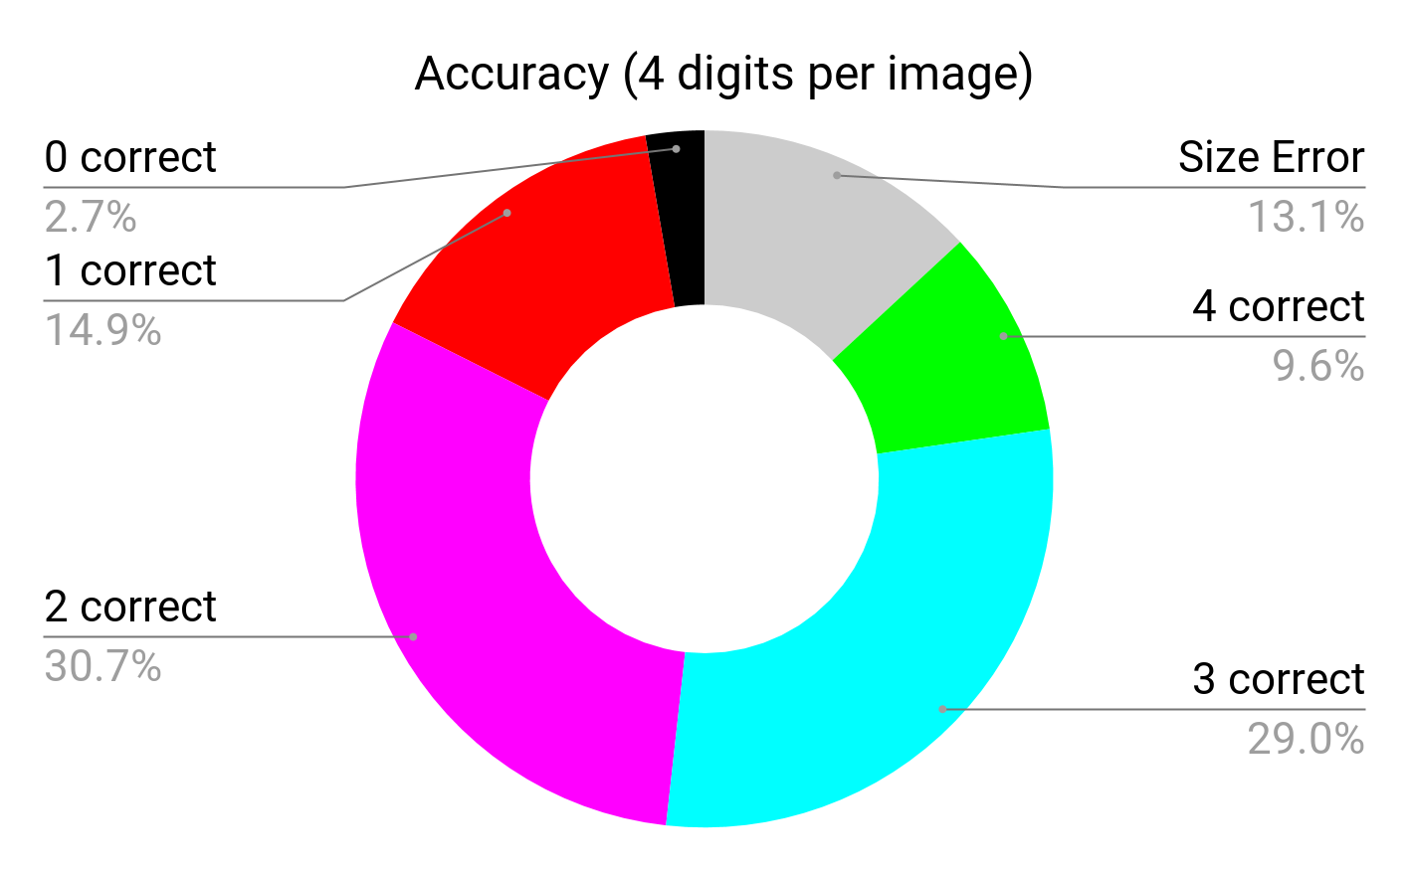
Decision Tree Classifier
17,500 images Accuracy (on 15,208) Mean: 0.580 SD: 0.246

Slide 11
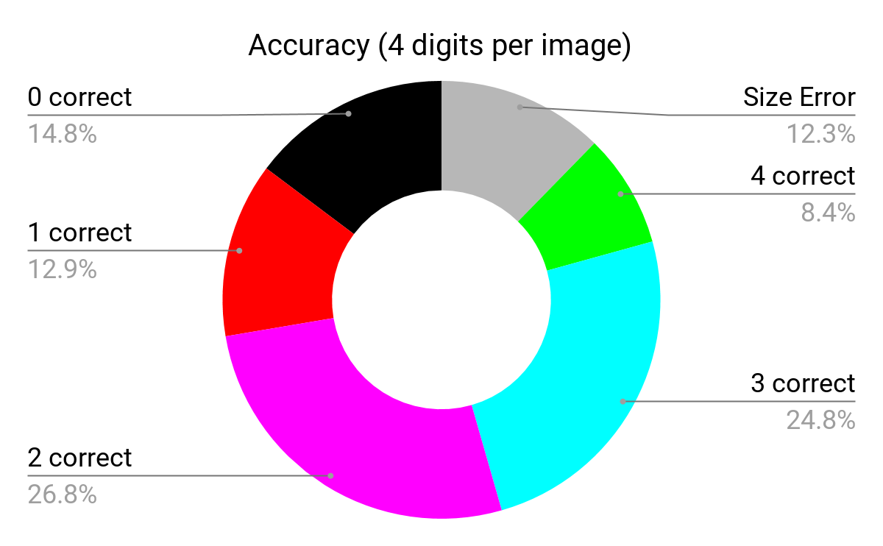
SVM Classifier
17,500 images Accuracy (on 15,042) Mean: 0.579 SD: 0.246

Slide 12
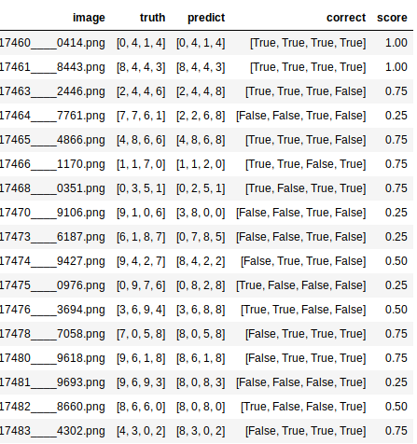
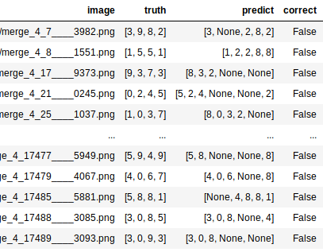
Results
Size Error results needs a deeper look.

Slide 13
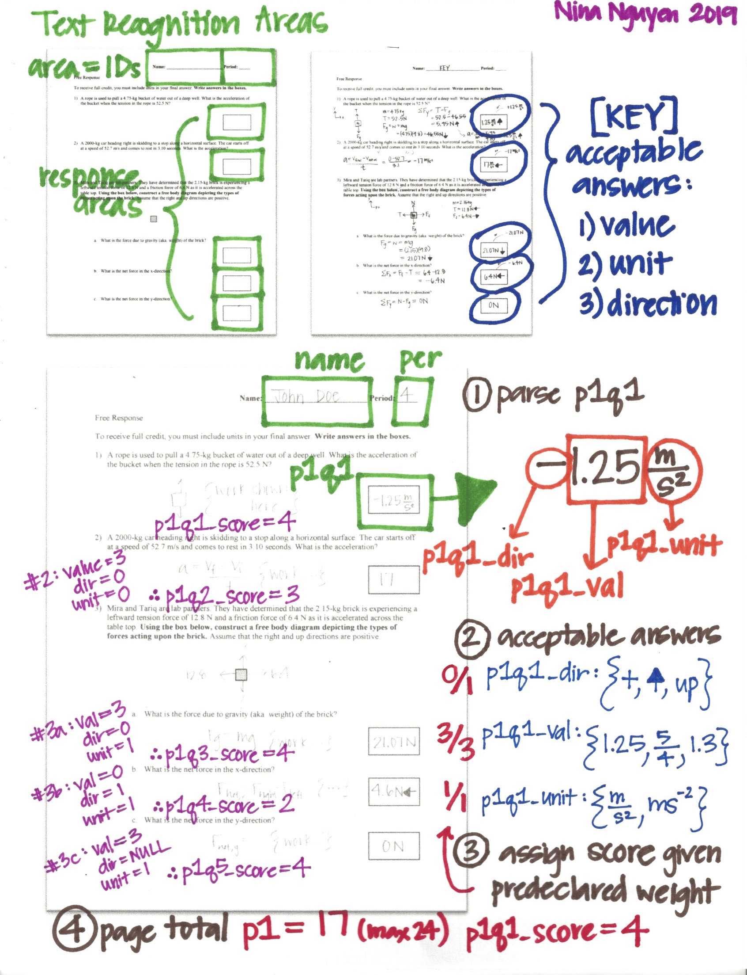
Nitty Gritty

Slide 14
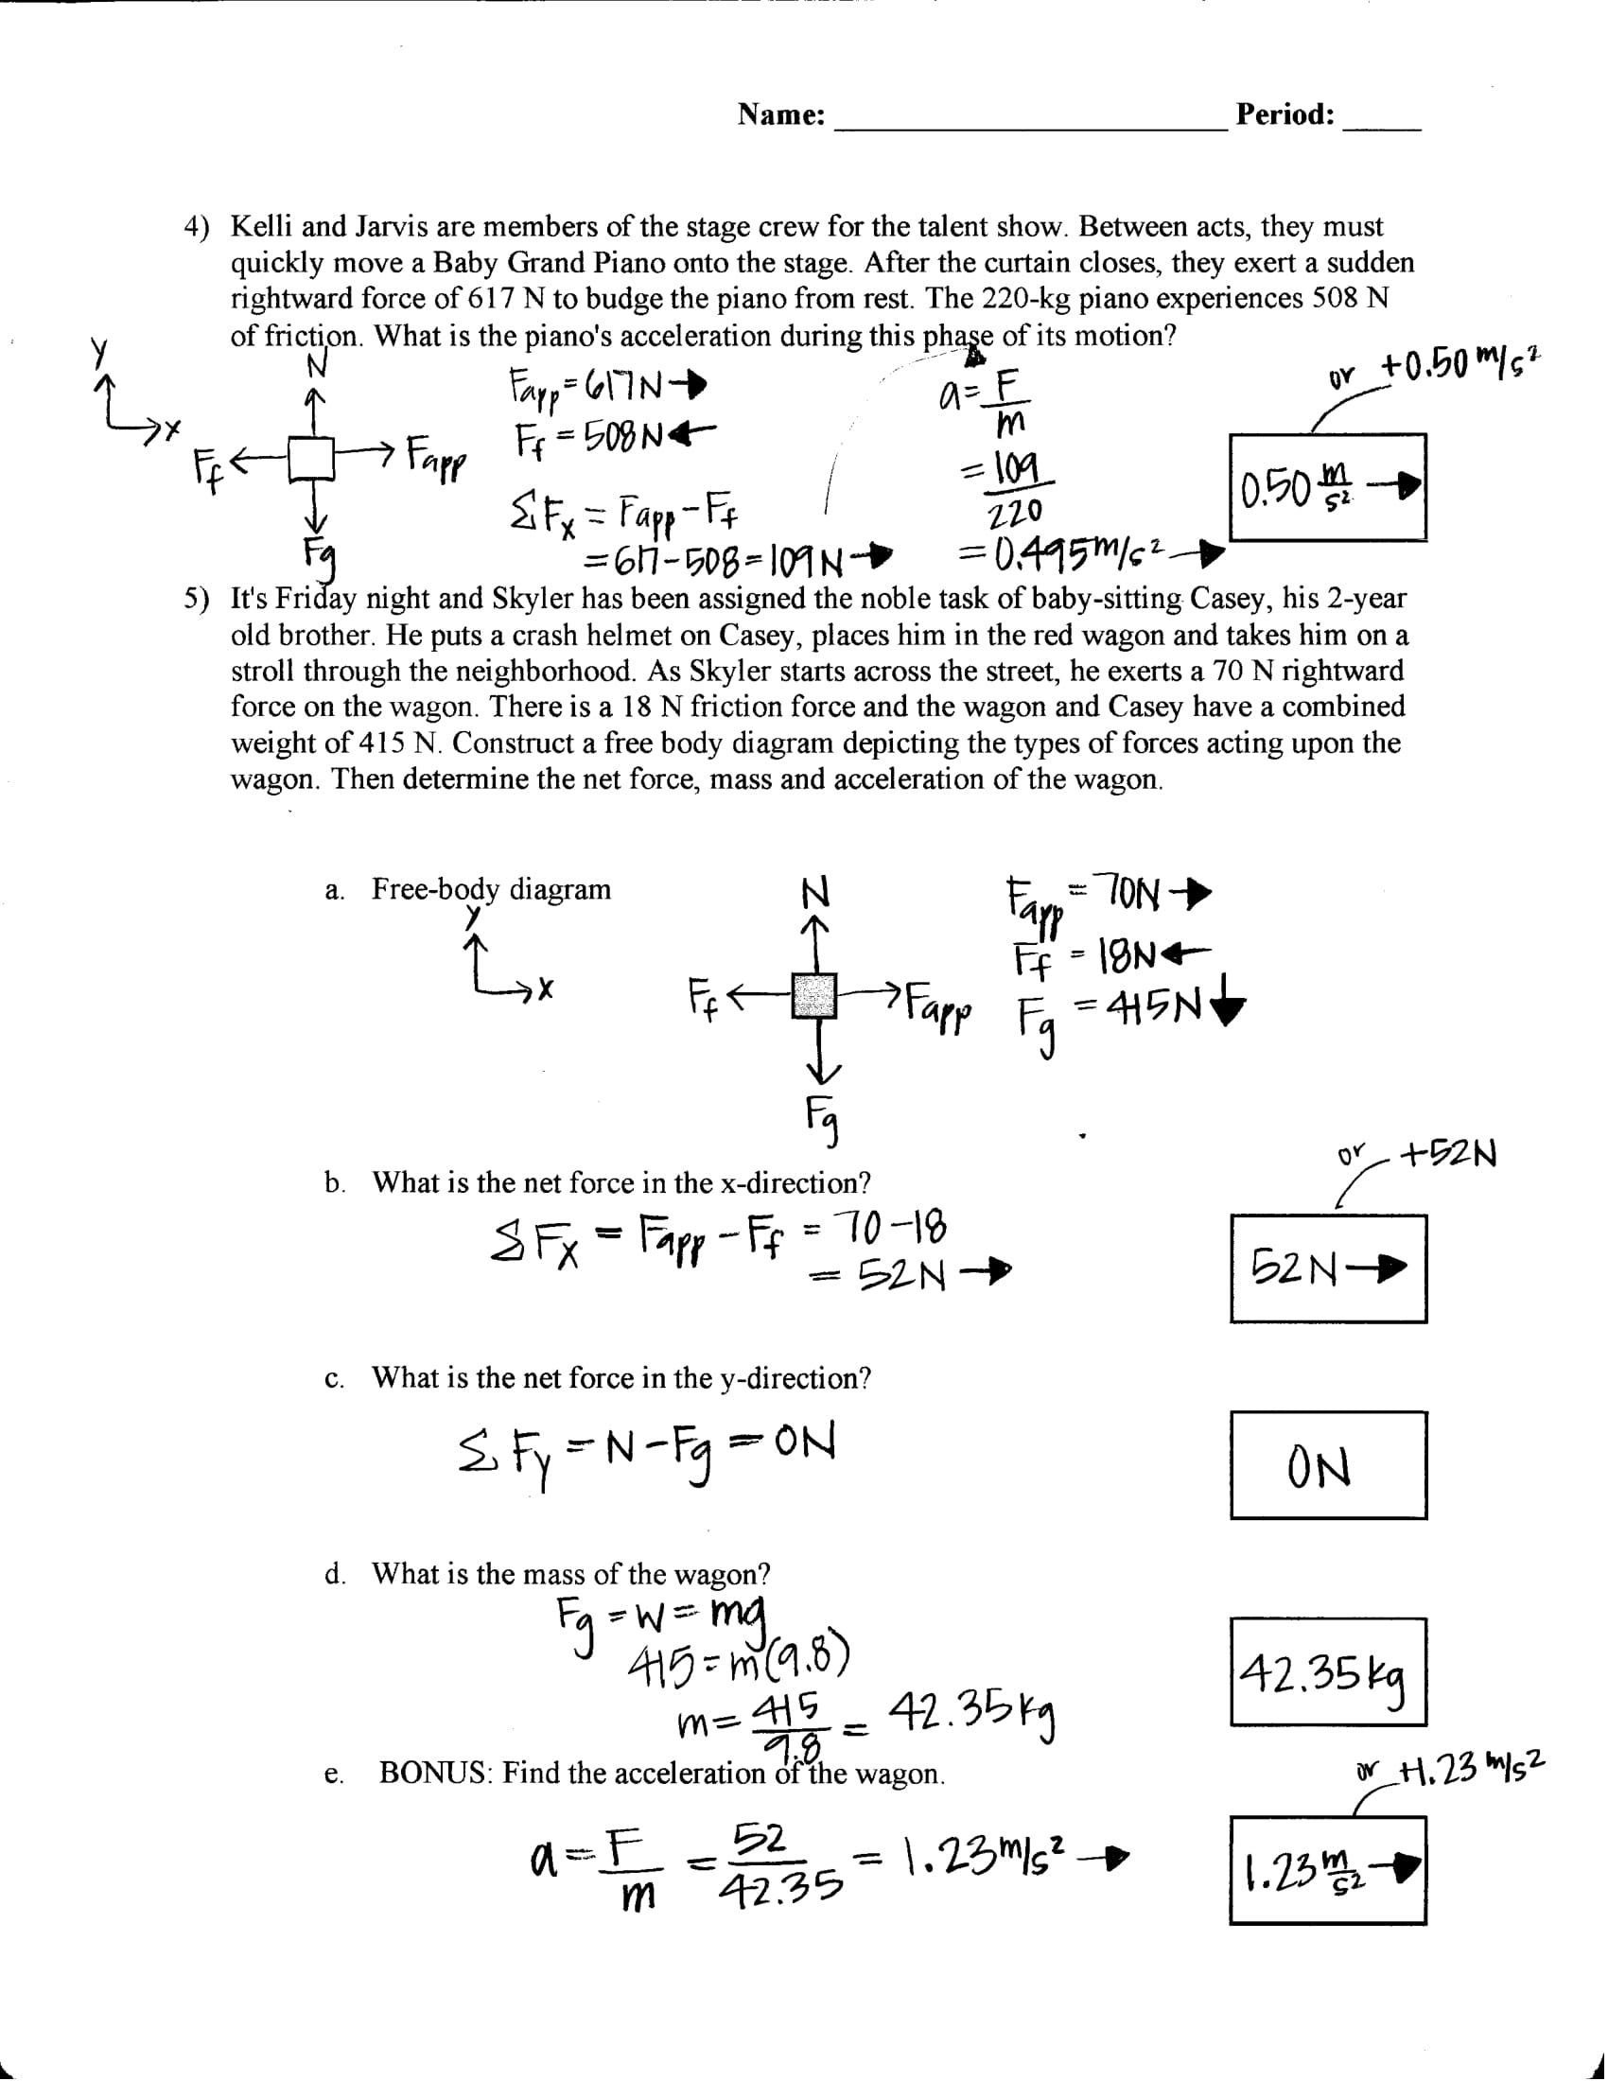
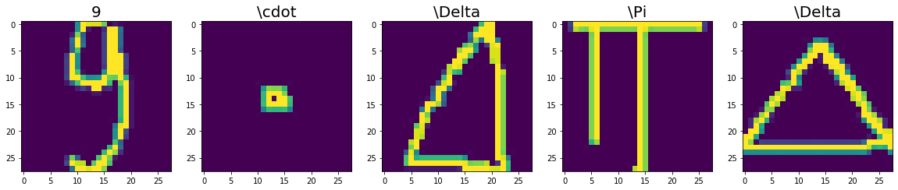
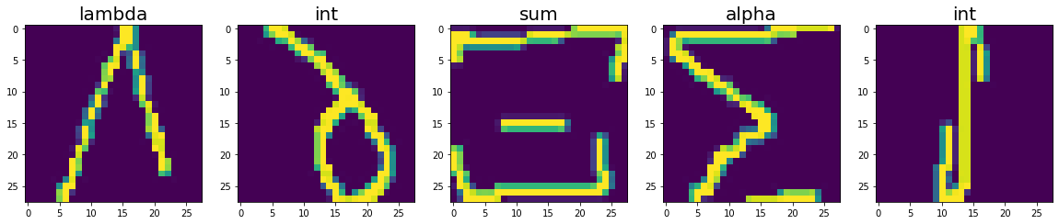
Future Directions
Units & direction
Organic chemistry
OCR + NLP

